Slide 1
Probability and Statistics
“Probability and Statistics for engineers and scientists” by “Ronald walepole”
“probability and statistics for engineering and the sciences” by “ lay l. devore”

Slide 2
Statistics
The term statistics can refer to numerical facts such as averages, medians, percents, and index numbers that help us understand a variety of business and economic situations.
Statistics can also refer to the art and science of collecting, analyzing, presenting, and interpreting data.

Slide 3
Types of statistics
Descriptive statistics: It deals with the concepts and methods concerned in summarization and description of the numerical data. e.g.
presentation of data
graphical display
Computation of few numerical quantities

Slide 4
Example: Hudson Auto Repair
Descriptive Statistics
The manager of Hudson Auto would like to have
a better understanding of the cost of parts used in the
engine tune-ups performed in the shop. She examines
50 customer invoices for tune-ups. The costs of parts,
rounded to the nearest dollar, are listed below.

Slide 5
Example: Hudson Auto Repair
Descriptive Statistics
Tabular Summary (Frequencies and Percent Frequencies)
Parts Percent
Cost ($) Frequency Frequency
50-59 2 4
60-69 13 26
70-79 16 32
80-89 7 14
90-99 7 14
100-109 5 10
Total 50 100

Slide 6
Example: Hudson Auto Repair
Descriptive Statistics
Graphical Summary (Histogram)
18
16
14
12
Frequency
10
8
6
4
2
Parts
Cost ($)
50 60 70 80 90 100 110

Slide 7
Numerical Descriptive Statistics
The most common numerical descriptive statistic is the average (or mean).
Hudson’s average cost of parts, based on the 50 tune-ups studied, is $79 (found by summing the 50 cost values and then dividing by 50).

Slide 8
Types of statistics
Inferential statistics :- The procedure for making inferences about population on the basis of sample observation.

Slide 9
Example: Hudson Auto Repair
Process of Statistical Inference
1. Population
consists of all
tune-ups. Average
cost of parts is
unknown.
2. A sample of 50
engine tune-ups
is examined.
4. The value of the
sample average is used
to make an estimate of
the population average.
3. The sample data
provide a sample
average cost of
$79 per tune-up.

Slide 10
Population and sample
Population :- A collection of all possible observations , objects, individuals , relevant to a single problem.
Or
The whole aggregate from which the sample is chosen.

Slide 11
sample
A sample is a subset of a population.
That representative part which is selected from an aggregate.

Slide 12
Statistic and parameter
Statistic:
Statistic (notice it is singular): A value, usually numerical, that describes a sample.
example: mean, median , and standard deviation.
Parameter:
A value, usually numerical, that describes a population

Slide 13
Datum:- single observation
Data:- set of observations.
Variable:- A characteristic that varies from person to person or object to object. e.g. age , height, marks, GPA, hair color, religion, race etc.
Types of variables:- two types of variables
Quantitative variable
Qualitative variable

Slide 14
Types of variable
Quantitative variable:- That characteristic which can be expressed numerically. e.g. Age, weight, income, profit, expenditures, number of students, etc.
Qualitative variable:- That characteristic which can not be expressed numerically. e.g. religion, hair color, intelligence, satisfaction, quality, poverty, education etc. Also called an attribute.

Slide 15
Types of quantitative variable
Discrete variable:- A variable that can take only a discrete set of integers or whole numbers, that is the values are taken by jumps or breaks. It represent count data.
Continuous variable:- A variable that can take on any value fractional or integral within a given interval. It represents measurement data. e.g. height, weight, age, temperature. etc

Slide 16
Types of Data
Qualitative (Categorical)
Quantitative
Cross sectional
Time series
Spatial

Slide 17
Cross-Sectional Data
Cross-sectional data are collected at the same or
approximately the same point in time.
Example: data detailing the number of building
permits issued in November 2012 in each of the
counties of Ohio

Slide 18
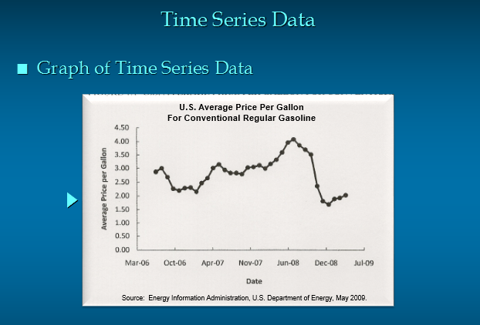

Slide 19
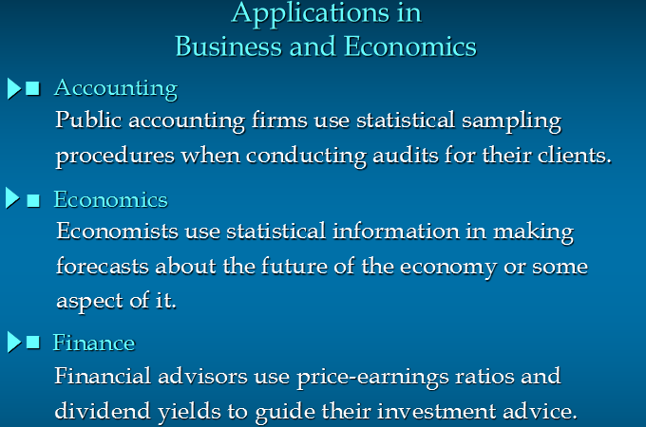

Slide 20
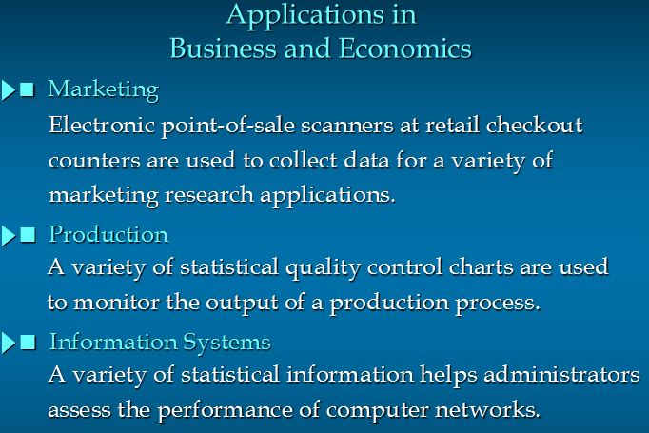

Slide 21
Computer Science
Statistics is used for data mining, speech recognition, vision and image analysis, data compression, artificial intelligence, and network and traffic modeling. A statistical background is essential for understanding algorithms and statistical properties that form the backbone of computer science

